Slide 1
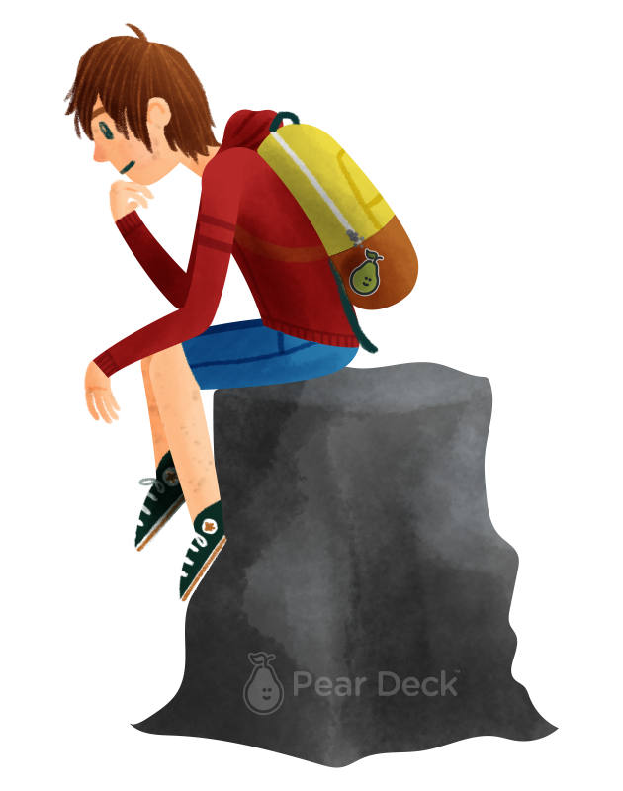
Recapitulare Grafuri Orientate
DLarisa
Grupa: 341
Facultatea de Matematică și Informatică
Notes:
Ask a Question
Use the template to prompt students to form a question. By asking them to consider a question their classmate might have, as opposed to their own question, you can help unlock their creative thinking and remove insecurities they might have around asking their own questions.
🍐 This is a Pear Deck Text Slide
🍐 To edit the type of question, go back to the "Ask Students a Question" in the Pear Deck sidebar.

Slide 2

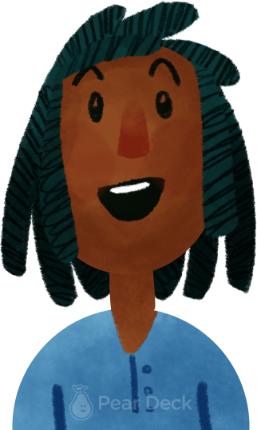
Să ne amintim!
Definiție:
Un Graf Orientat este o pereche ordonată de mulțimi, notată G = (V, U), unde:
V -> mulțime finită și nevidă ale cărei elemente se numesc noduri sau vârfuri;
U -> mulțime de perechi ordonate de elemente distincte din V, ale cărei elemente se numesc arce.
Notes:
Thinking Broadly
Identifying and articulating questions we have is an important thinking skill. Give students the opportunity to think broadly about today’s topic and identify their own questions. Show their responses anonymously on the projector to discuss.
🍐 This is a Pear Deck Text Slide
🍐 To edit the type of question, go back to the "Ask Students a Question" in the Pear Deck sidebar.

Slide 3
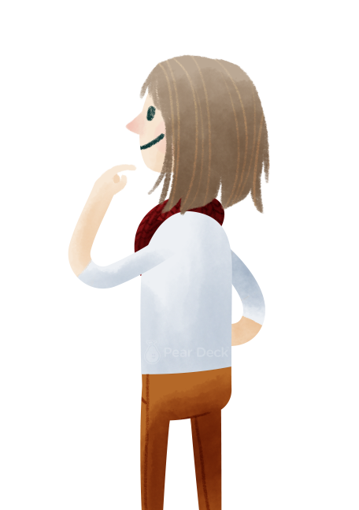
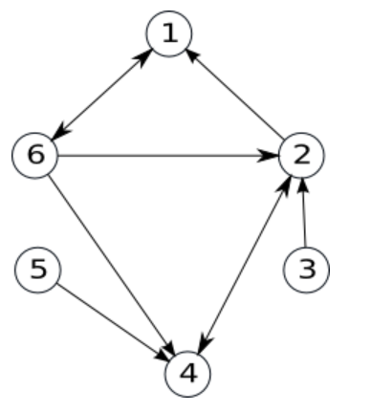
Exemplu Graf Orientat:
V = {1, 2, 3, 4, 5, 6}
U = {(1, 6); (2, 1); (2, 4); (3, 2); (4, 2); (5, 4); (6, 1); (6, 2); (6, 4)}
!!! Obs: Arcele (6, 1) și (1, 6) sunt diferite; spre deosebire de grafurile neorientate, unde nu exista nicio diferență.
Notes:
Homework Reflection Use this template to prompt students to consider takeaways from the homework. You can change the prompt to fit your content.
🍐 This is a Pear Deck Text Slide
🍐 To edit the type of question, go back to the "Ask Students a Question" in the Pear Deck sidebar.

Slide 4
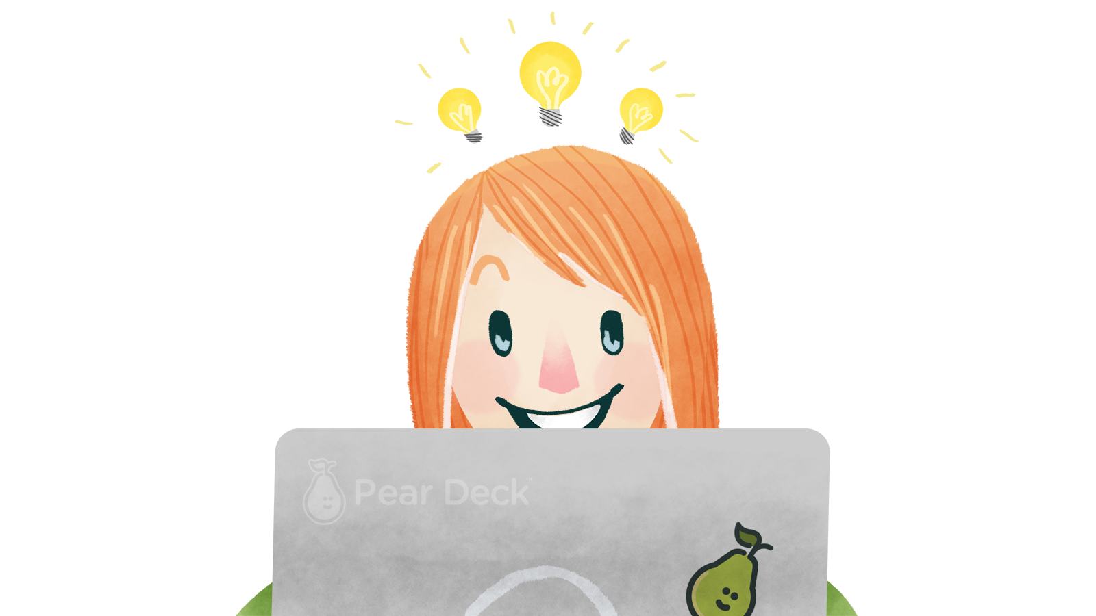
Într-un arc de forma u = (x, y), nodurile sunt ___. Nodul ‘x’ se numește ___ nodului ‘y’, iar ‘y’ se numește ___ nodului ‘x’.
Notes:
🍐 This is a Pear Deck Text Slide
🍐 To edit the type of question, go back to the "Ask Students a Question" in the Pear Deck sidebar.
Summarize
Have students write a quick, 1-2 sentence summary of the information they’ve just learned.

Slide 5
Răspuns Corect:
Într-un arc de forma u = (x, y), nodurile sunt adiacente. Nodul ‘x’ se numește predecesorul nodului ‘y’, iar ‘y’ se numește succesorul nodului ‘x’.
Notes:
Summarize
Have students write a quick, 1-2 sentence summary of the information they’ve just learned.
🍐 This is a Pear Deck Text Slide
🍐 To edit the type of question, go back to the "Ask Students a Question" in the Pear Deck sidebar.

Slide 6
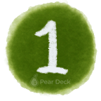
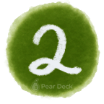
Să ne amintim!
Gradul Nodurilor
Grad Exterior:
Gradul exterior al nodului / vârfului ‘x’ este dat de numărul arcelor de forma (x, y) (i.e. numărul arcelor care ies din ‘x’) și este notat: d+(x).
Grad Interior:
Gradul interior al nodului / vârfului ‘x’ este dat de numărul arcelor de forma (y, x) (i.e. numărul arcelor care intră din ‘x’) și este notat: d-(x).
Notes:
Transition Template
Transitions between class periods or between activities within a class period can be times for confusion and chaos - it’s an easy time for students to become distracted, and before you know it, you’ve lost their attention. Help students know what to expect by using this slide to articulate clear steps for wrapping up one activity and prepare for the next. Try to keep the list to no more than three steps if you can.

Slide 7
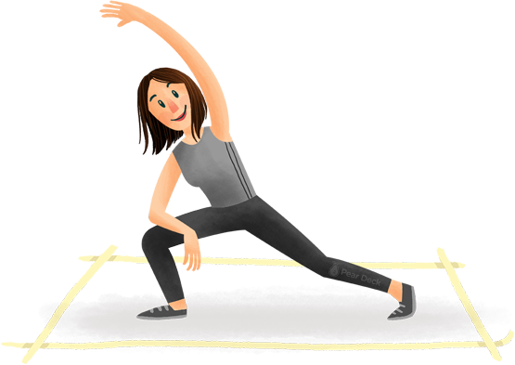
Scrieți răspunsul Corect!
d+(2) = ?
Notes:
🍐 This is a Pear Deck Number Slide
🍐 To edit the type of question, go back to the "Ask Students a Question" in the Pear Deck sidebar.
Stretch Break
Movement helps us learn! If students have been sitting too long, they might be struggling to pay attention and engage deeply in the content. Use this slide as a reminder to get up and stretch, or incorporate a kinetic activity into your lesson.

Slide 8
Scrieți răspunsul Corect!
d-(2) = ?
Notes:
🍐 This is a Pear Deck Number Slide
🍐 To edit the type of question, go back to the "Ask Students a Question" in the Pear Deck sidebar.
Stretch Break
Movement helps us learn! If students have been sitting too long, they might be struggling to pay attention and engage deeply in the content. Use this slide as a reminder to get up and stretch, or incorporate a kinetic activity into your lesson.

Slide 9
Răspunsuri Corecte:
d+(2) = 2
d-(2) = 3
Notes:
Homework Reflection Use this template to prompt students to consider takeaways from the homework. You can change the prompt to fit your content.
🍐 This is a Pear Deck Text Slide
🍐 To edit the type of question, go back to the "Ask Students a Question" in the Pear Deck sidebar.

Slide 10

!!! Teoremă:
Într-un graf orientat, suma gradelor exterioare a tuturor nodurilor este egală cu suma gradelor interioare a tuturor nodurilor și este egală cu numărul de arce.
Notes:
Takeaway
Use this template to help students articulate and retain their biggest takeaways from the day.
🍐 This is a Pear Deck Text Slide
🍐 To edit the type of question, go back to the "Ask Students a Question" in the Pear Deck sidebar.

Slide 11

Graf Orientat cu Nod Izolat...
Să ne amintim ce este un nod izolat. Folosiți zona albă pentru a desena un graf orientat care să conțină un nod izolat.
Notes:
🍐 This is a Pear Deck Drawing Slide
🍐 To edit the type of question, go back to the "Ask Students a Question" in the Pear Deck sidebar.
Instructions Template
Use this template to display instructions for your activity. Everyone works at a different pace. Help students who finish early know appropriate ways to use their time. For example, maybe you want them to help their peers, discuss with a peer, move on to a more advanced activity, or do some quiet reading.

Slide 12
!!! De Reținut:
Un nod, x, se numește izolat dacă d+(x) = d-(x) = 0.
Notes:
Takeaway
Use this template to help students articulate and retain their biggest takeaways from the day.
🍐 This is a Pear Deck Text Slide
🍐 To edit the type of question, go back to the "Ask Students a Question" in the Pear Deck sidebar.

Slide 13

Există mai multe metode de reprezentare pe calculator a grafurilor orientate:
Matricea de Adiacență:
Matricea de adiacență conține n linii și n coloane, fiind formată numai din {0, 1}, astfel:
A[i][j] = 1, dacă există arcul (i, j)
0, dacă nu există (i, j)
Ex:
0 0 0 0 0 1
1 0 0 1 0 0
0 1 0 0 0 0
0 1 0 0 0 0
0 0 0 1 0 0
1 1 0 1 0 0
În calculator, putem reprezenta matricea de adiacență folosind o matrice: int A[10][10].
Lista de Arce:
După cum îi sugerează numele, lista de arce este o mulțime ce conține toate arcele din graf. Ex:
U = {(1, 6); (2, 1); (2, 4); (3, 2); (4, 2); (5, 4); (6, 1); (6, 2); (6,4)}
În calculator, putem folosi o listă / un vector de struct {int i, j}.
Listele de Adiacență:
Pentru un graf orientat, vom reține numărul de noduri n și pentru fiecare nod, x, vom reține lista succesorilor săi. Ex: 1: 6
2: 1, 4
3: 2
4: 2
6: 1, 2, 4
În calculator, putem folosi n tablouri unidimensionale, alocate dinamic.
Notes:
Bell-Ringer or Do-Now Transitioning from the hallway into class can be a chaotic time. Use this slide to help students know what to expect as they come into the room, and change the instructions to fit your activity.
🍐 This is a Pear Deck Text Slide
🍐 To edit the type of question, go back to the "Ask Students a Question" in the Pear Deck sidebar.

Slide 14
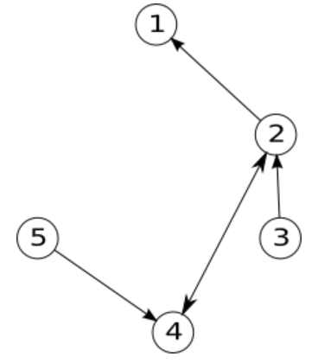
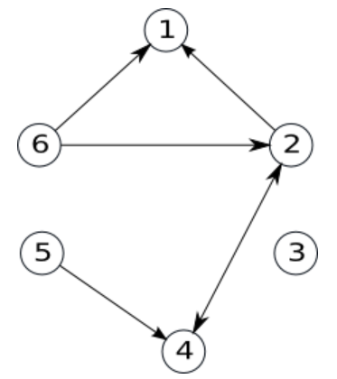
Să Ne Reamintim:
Subgraf:
Un subgraf se obține din graful inițial ștergând anumite noduri și toate arcele incidente cu respectivele noduri.
Graf Inițial:
Graf Parțial:
Graful Parțial are același număr de noduri precum graful inițial, dar un număr diferit de arce.
Notes:
Bell-Ringer or Do-Now Transitioning from the hallway into class can be a chaotic time. Use this slide to help students know what to expect as they come into the room, and change the instructions to fit your activity.
🍐 This is a Pear Deck Text Slide
🍐 To edit the type of question, go back to the "Ask Students a Question" in the Pear Deck sidebar.

Slide 15
Timpul pentru o scurtă competiție Kahoot :) !
Vă rog să intrați pe telefon ca să puteți juca.
Link Kahoot pentru profesor: https://create.kahoot.it/share/grafuri-orientate/20243094-0a77-42d7-8a66-1e3b878ceac5
Notes:
Homework Reflection Use this template to prompt students to consider takeaways from the homework. You can change the prompt to fit your content.
🍐 This is a Pear Deck Text Slide
🍐 To edit the type of question, go back to the "Ask Students a Question" in the Pear Deck sidebar.

Slide 16
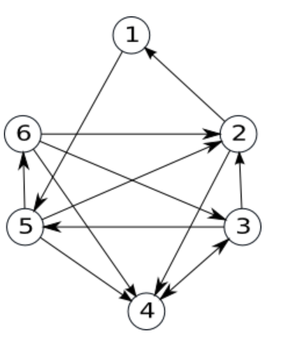

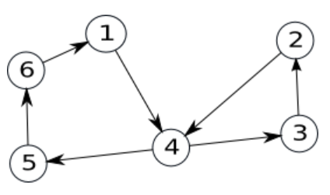
Graf Hamiltonian vs Graf Eulerian
Graf Hamiltonian:
Un drum elementar care conține toate nodurile grafului se numește drum hamiltonian.
Un circuit elementar care conține toate nodurile grafului se numește circuit hamiltonian.
Un graf care conține un circuit hamiltonian se numește graf hamiltonian.
Graf Eulerian:
Un drum care conține toate arcele grafului se numește drum eulerian.
Un circuit care conține toate arcele grafului se numește circuit eulerian.
Un graf care conține un circuit eulerian se numește graf eulerian.
Notes:
Real-Life Relevance
Use this template to help students connect the lesson to their own life. Does something from class relate to something they learned in another class? Was something interesting or surprising? Will it be useful to them? Did they learn anything that someone else they know would be interested to hear about? Helping students make those connections will help them retain the information, because it becomes more relevant to their lives.
🍐 This is a Pear Deck Drawing Slide
🍐 To edit the type of question, go back to the "Ask Students a Question" in the Pear Deck sidebar.

Slide 17



Cât de folositoare vi s-a părut această recapitulare?
Notes:
🍐 This is a Pear Deck Draggable™ Slide.
🍐 To edit the type of question, go back to the "Ask Students a Question" in the Pear Deck sidebar.
Hard or Easy
Use this template to do a quick temperature check and self-reflection about the homework. You can learn which students might have struggled with the assignment and therefore might need more attention today.

Slide 18
Ați mai dori să participați la o astfel de recapitulare?
Notes:
🍐 This is a Pear Deck Draggable™ Slide.
🍐 To edit the type of question, go back to the "Ask Students a Question" in the Pear Deck sidebar.
Hard or Easy
Use this template to do a quick temperature check and self-reflection about the homework. You can learn which students might have struggled with the assignment and therefore might need more attention today.

Slide 19
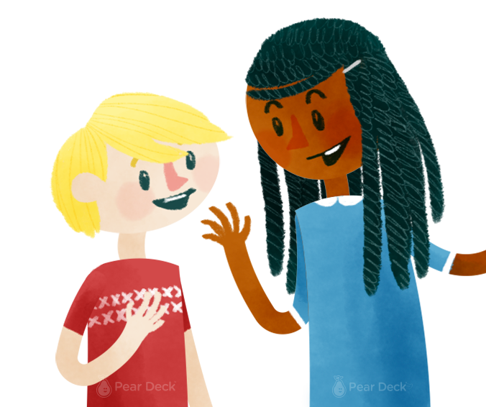
Resurse pentru a vă pregăti de test: 1. https://www.pbinfo.ro/
2. https://www.infoarena.ro/
3. https://invata.info/2017/04/01/teorie-grafuri-orientate-c/
4. Manualul
5. Mă puteți contacta pe Google Classrom pentru întrebări.
Notes:
Summarize
Use the template to prompt students to think about the most important aspects of the lesson. By asking them to consider their friend, you help them develop the skills to consider another person’s needs and learn to summarize information.
🍐 This is a Pear Deck Text Slide
🍐 To edit the type of question, go back to the "Ask Students a Question" in the Pear Deck sidebar.

Slide 20
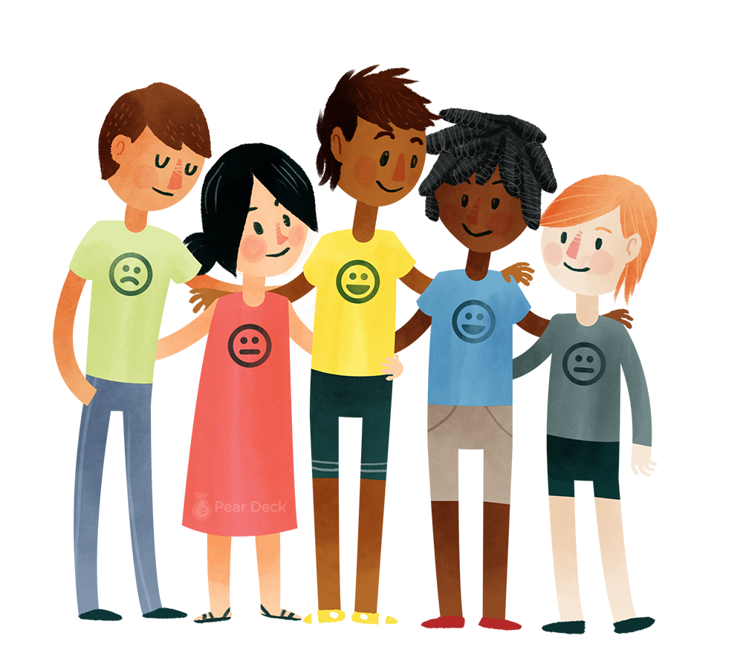
Vă mulțumesc pentru participare!
Notes:
Thank You This slide helps recognize good classroom citizens, and helps kids feel rewarded for being kind and compassionate to each other. You can review responses in the Teacher Dashboard before presenting to the class.
🍐 This is a Pear Deck Text Slide
🍐 To edit the type of question, go back to the "Ask Students a Question" in the Pear Deck sidebar.

